Slide 1
Optimisation and the Chocolate Factory:
The Logistics
Iman Kazemian
University of Tehran
Samin Aref
University of Auckland
NZMS Colloquium, 1 December 2015 Christchurch
Notes:
This template can be used as a starter file for presenting training materials in a group setting.
Sections
Right-click on a slide to add sections. Sections can help to organize your slides or facilitate collaboration between multiple authors.
Notes
Use the Notes section for delivery notes or to provide additional details for the audience. View these notes in Presentation View during your presentation.
Keep in mind the font size (important for accessibility, visibility, videotaping, and online production)
Coordinated colors
Pay particular attention to the graphs, charts, and text boxes.
Consider that attendees will print in black and white or grayscale. Run a test print to make sure your colors work when printed in pure black and white and grayscale.
Graphics, tables, and graphs
Keep it simple: If possible, use consistent, non-distracting styles and colors.
Label all graphs and tables.

Slide 2
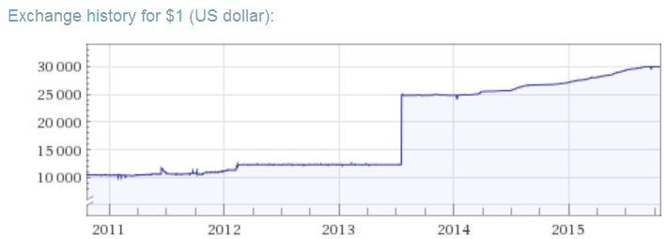
Motivation
An abrupt change in Iran economy
2X

Slide 3
Response from Logistics Managers
An agile change in planning paradigm
Planning under uncertainty

Slide 4

A Chocolate Factory
Size: 15000 employees
Challenge: where to establish distribution hubs?
Uncertainty in decision parameters
Demand variability

Slide 5
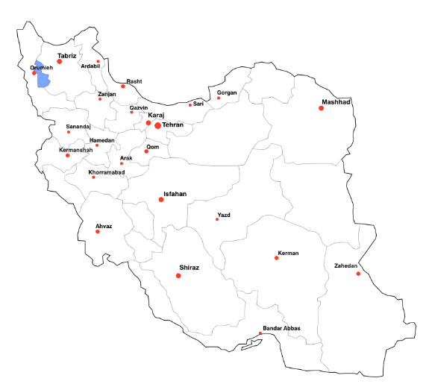
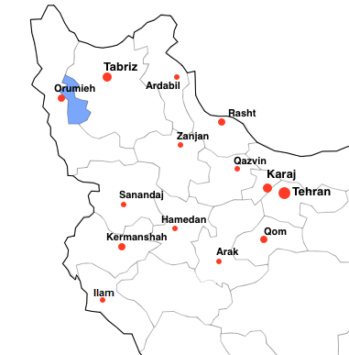
North-west part of Iran

Slide 6
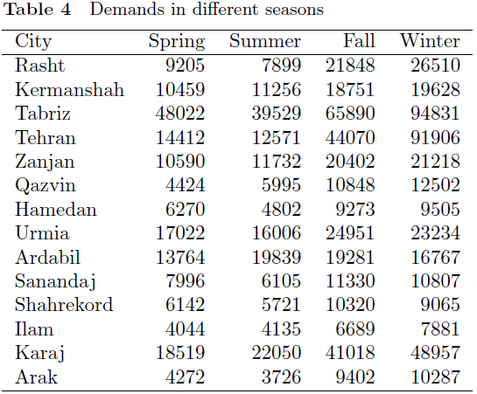
Demand of products (as a whole) in different cities
in different times of the year
?

Slide 7
Literature Review
(Owen and Daskin 1998)
(Ghaffari-nasab et al. 2015)
(Snyder 2006)
(Hult et al. 2014)
(Alumur et al. 2008)
(Alumur et al. 2012)
(Kara and Tansel 2003)
(Campbell et al. 2005)
(Yang 2009)
(Correia et al. 2011)
(Farahani et al. 2013)
(O’Kelly 1986) (Aykin 1990) (Campbell 1994)
(Bertsimas et al. 2004)
(Snyder and Daskin 2006)
(Snyder et al. 2007)
(Snyder and Daskin 2005)
(Yaman 2008)
(Sim et al. 2009)
(Contreras et al. 2011)
(Correia et al. 2014)
(Ebery et al. 2000)
(Abidi et al. 2015)
(Marianov and Serra 2003)
(Campbell and O’Kelly 2012)
Stochastic optimisation
Robust optimisation
Deterministic optimisation
Other approaches

Slide 8

Problem Definition
Notes:
This is another option for an Overview slides using transitions.

Slide 9
Logistics network design
Uncertain hub establishment cost
Seasonal demand variability

Slide 10

Assumptions

Slide 11

Demand fluctuations can be described by considering a limited number of scenarios.
In each scenario demand parameters are certain values.
Uncertain setup cost is assumed to be incorporated in a limited number of scenarios.
Probabilities of scenarios can be unknown.

Slide 12
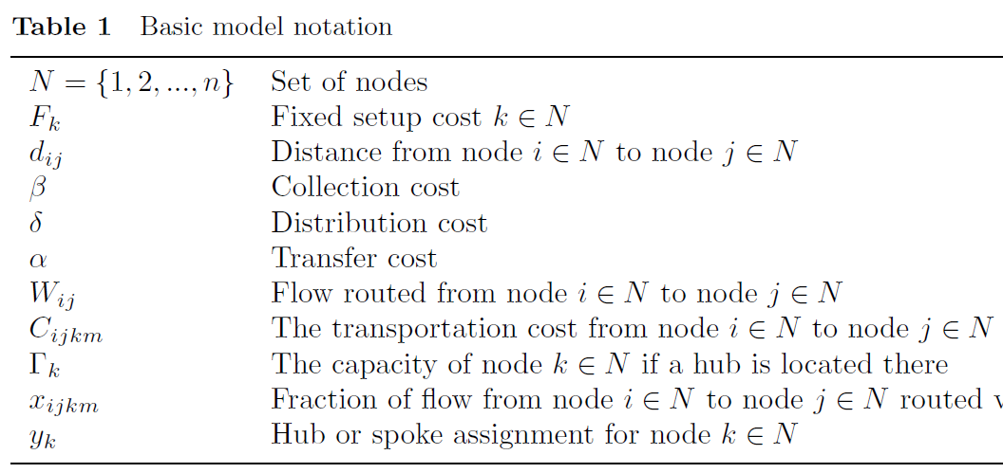
Notation
Fixed cost
Demand
Cost
Capacity
Decision
Decision
(Campbell 1994)

Slide 13
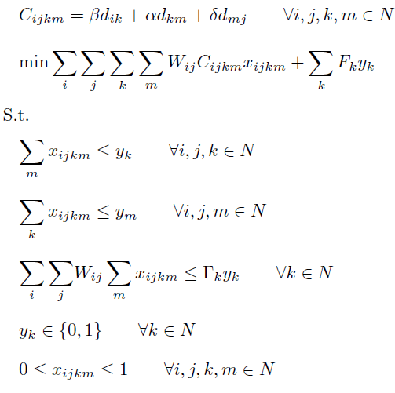
A Basic Deterministic Model
(Built on Campbell 1994)
Notes:
Use a section header for each of the topics, so there is a clear transition to the audience.

Slide 14
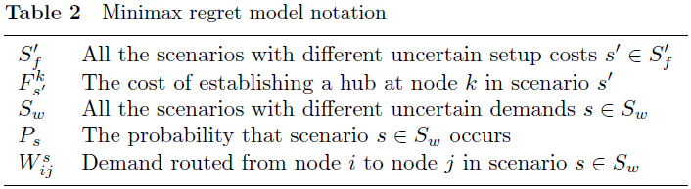

Notation
Optimal objective function value for the basic model in scenario
Notes:
Use a section header for each of the topics, so there is a clear transition to the audience.

Slide 15
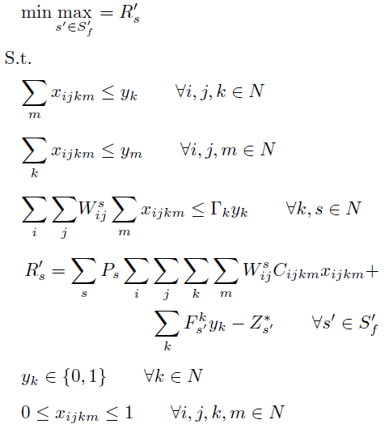
A Robust Optimisation Model
(Minimax regret)
Notes:
Use a section header for each of the topics, so there is a clear transition to the audience.

Slide 16
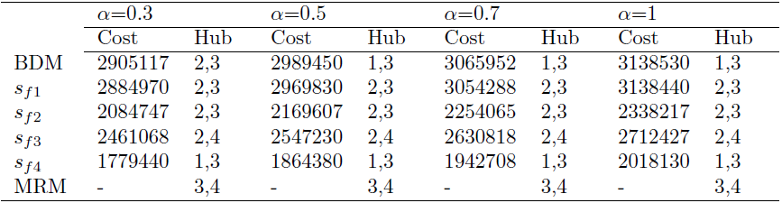
Results for Yang (2009) hub location problem obtained by the two models
*
*
BDM: Basic Deterministic Model
Sf: Demand Scenarios
MRM: Minimax Regret Model

Slide 17

Back to the main problem
We divide the year into 4 seasons with certain demand values

Slide 18
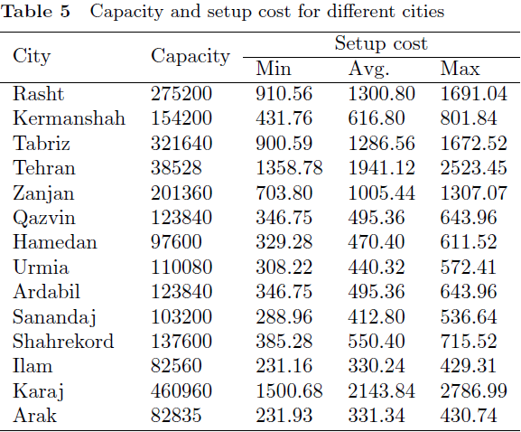
Decision Parameters (capacity and cost)
We consider 5 certain scenarios for setup cost

Slide 19
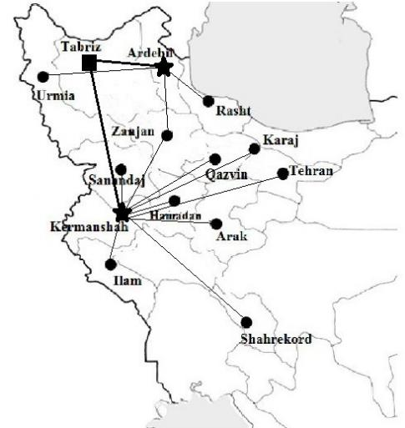
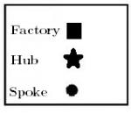
Solved by BDM using average values

Slide 20
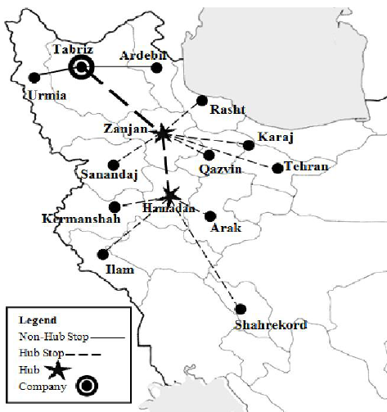
Solved by Seasonal optimisation
for the last season
Hub Location under Uncertainty
Samin Aref (UoA)

Slide 21
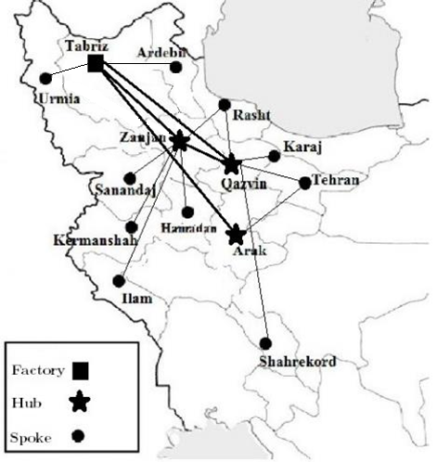
Solved by MRM to be implemented throughout the planning horizon
Hub Location under Uncertainty
Samin Aref (UoA)

Slide 22
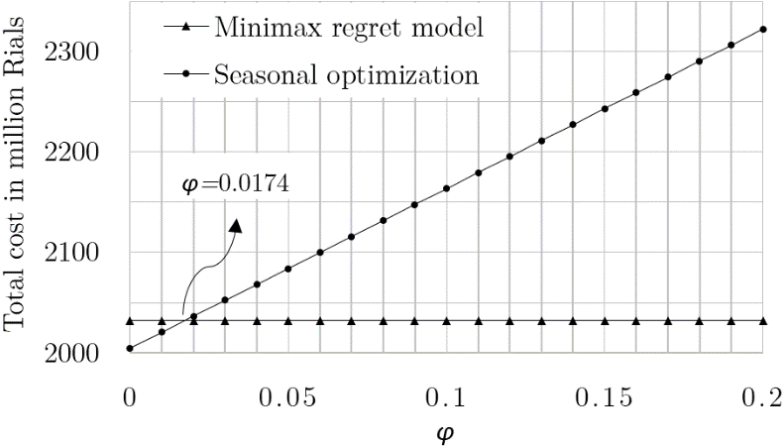
Break-even point based on total annual cost
: the ratio of re-configuration cost to the average cost of hub establishment
Hub Location under Uncertainty
Samin Aref (UoA)

Slide 23
Thank You
Questions?

